Slide 1
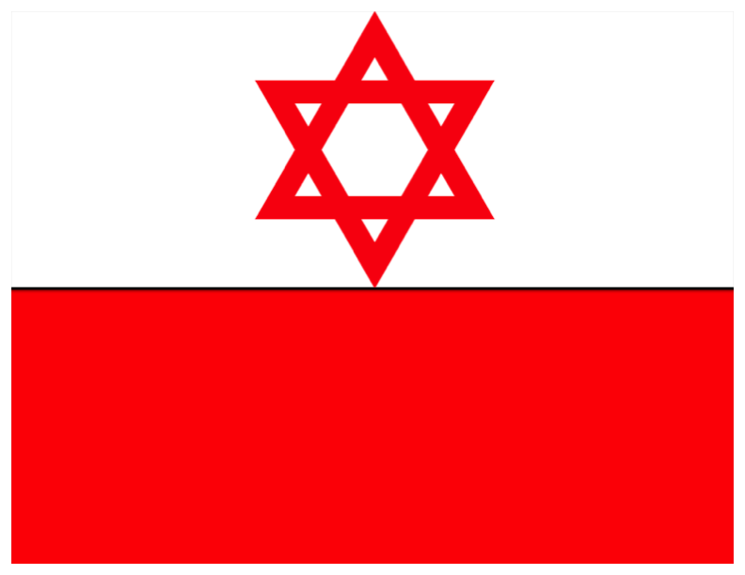
Modern Anti-Semitism in Poland
By Noah Botman

Slide 2
Polish Jewry Today
A 1900 census showed that there were over 1.3 million Jews in Poland, which was over 16% of the population at the time.
After the war, there were between 180,000 and 240,000 Jews, less than 1% of the population.
Today, there are fewer than 4,000 Jews, in a country of 38 million.
Bar mitzvah of a Jewish boy in Warsaw
Source 1: jewishencyclopedia.com “Statistics” http://www.jewishencyclopedia.com/articles/13992-statistics (accessed May 5, 2012).
Source 2: ushmm.org, “Jewish Population of Europe in 1945”, http://www.ushmm.org/wlc/en/article.php?ModuleId=10005687 (accessed May 5, 2012).
Source 3 and Picture: Helena Datner, difficultquestions.org, “Are there any Jews still living in Poland” http://www.difficultquestions.org/ (accessed April 29, 2013).
Notes:
http://www.jewishencyclopedia.com/articles/13992-statistics

Slide 3
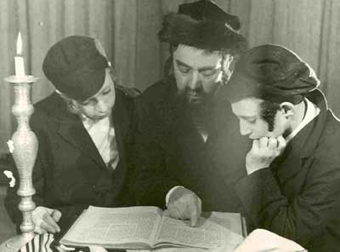
A Brief Look Back (Part 1)
Jews lived in Poland for over a millennium before the Holocaust.
They had lived fruitful lives in a country that treated its Jewish community well, compared to other European countries at the time.
Jews admired Poland so much, they called it , translating roughly into “here we can rest.” It was also known as paradisus Iudaeorum (Jewish paradise in Latin), since it provided a safe haven from persecution for Jews across Europe.
Jewish Children Studying in pre-WWII Poland
Source: jewishmuseum.org, “Paradisus Iudaeorum”, http://www.jewishmuseum.org.pl/en/cms/paradisus-iudaeorum/ (accessed May 5, 2012).
Picture: Courtesy of Google Images.

Slide 4
A Brief Look Back (Part 2)
From the 17th Century on, religious tolerance in Poland decreased, and Anti-Semitism grew steadily.
When WWII started and Germany invaded Poland, the situation of the Jewish people drastically deteriorated under the Nazis’ rule of terror.
Many Poles would report Jews to the Nazis out of hatred, while other Poles would hide Jews from the Nazis (some would charge money, but others would not).
The majority of Poles stood by, not interfering out of fear of Nazi reprisal.
Source 1: Lonnie R. Johnson, Central Europe: Enemies, Neighbors, Friends (London: Oxford University Press, 1996).
Source 2: William W. Hagen, Before the "Final Solution": Toward a Comparative Analysis of Political Anti-Semitism in Interwar Germany and Poland, The Journal of Modern History, Vol. 68, No. 2 (Jun., 1996), 351–381.
Notes:
William W. Hagen, Before the "Final Solution": Toward a Comparative Analysis of Political Anti-Semitism in Interwar Germany and Poland, The Journal of Modern History, Vol. 68, No. 2 (Jun., 1996), 351–381.
"Central Europe: Enemies, Neighbors, Friends" by Lonnie R. Johnson Oxford University Press 1996

Slide 5
A Brief Look Back (Part 3)
Close to 1.5 million Polish Jews perished in the Holocaust.
After the Holocaust, somewhere between 180,000 and 240,000 Jews remained in Poland, but most left soon after. At this time, Poland became a communist satellite state for the USSR.
From 1946 to 1967 there was little anti-Semitism, as the few remaining Jews were either completely separate from Polish society, or they were totally assimilated.
Source 1: ushmm.org, “Jewish Population of Europe in 1945”, http://www.ushmm.org/wlc/en/article.php?ModuleId=10005687 (accessed May 5, 2012).
Source 2: Robert Blobaum, Antisemitism and its Opponents in Modern Poland (New York: Cornell University Press, 1996).
Notes:
http://www.ushmm.org/wlc/en/article.php?ModuleId=10005687

Slide 6
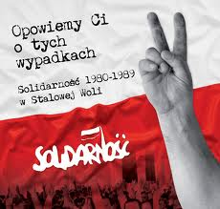
A Brief Look Back (Part 4)
When the Six Day War of 1967 between Israel and the Arabs started, the USSR was backing the Arabs. As a result, most communist states had anti-Israel campaigns, which were in reality
anti-Jewish.
By the time Poland became a capitalist democracy in 1990, there were only a handful of Jews remaining in Poland.
Polish Solidarity Revolution Poster
Source 1: Robert Blobaum, Antisemitism and its Opponents in Modern Poland (New York: Cornell University Press, 2005).
Source 2: Helena Datner, difficultquestions.org, “Are there any Jews still living in Poland” http://www.difficultquestions.org/ (accessed April 29, 2013).
Picture: Courtesy of Google Images.
Notes:
Image source: http://jesusedmundocoronadocontreras.blogspot.ca/2010/04/solidarnosc.html

Slide 7
Life for Jews in Modern Poland
Compared to life in other European countries, the small community of Jews in Poland suffers only rarely from random acts of Anti-Semitism.
This does not mean such acts do not exist, as Jews are sometimes verbally accosted on the streets if they have obvious Jewish features. These incidents often end quickly, however, as a result of intervening bystanders.
Jewish Wedding in Modern Day Poland
Source: Konstanty Gebert, difficultquestions.org, “Is it Dangerous to be a Jew in Poland Today” http://www.difficultquestions.org/ (accessed April 29, 2013).
Notes:
http://www.difficultquestions.org/

Slide 8
Acts of Modern Anti-Semitism
In recent years, there have been some Anti-Semitic incidents in Poland, such as stones being thrown at the Jewish Historical Institute, and attempted arson to the Warsaw Synagogue.
Despite this, only recently has their been a need for more security in Jewish neighborhoods, and the security is nothing like that needed in western Europe.
Source: Konstanty Gebert, difficultquestions.org, “Is it Dangerous to be a Jew in Poland Today” http://www.difficultquestions.org/ (accessed April 29, 2013).

Slide 9
Anti-Semitism in Modern Polish Culture
There are some regions in Poland that are more Anti-Semitic than others. Lodz, a poor city in Poland, is the home of most Polish Neo-Nazis.
During soccer, (“football”) matches, many hooligans, while intoxicated, will insult the other team by calling them Jews.
Anti-Semitic acts are usually less violent than in Western Europe. There have been several incidents of Anti-Semitic graffiti or vandalism on some buildings and in Jewish cemeteries.
Source 1: Konstanty Gebert, difficultquestions.org, “Is it Dangerous to be a Jew in Poland Today” http://www.difficultquestions.org/ (accessed April 29, 2013).
Source 2: shalomlife.com, “EXCLUSIVE: Adam Zucker’s ‘The Return’ Explores Jewish Culture in Modern Poland” http://www.shalomlife.com/culture/19185/exclusive-adam-zuckers-the-return-explores-jewish-culture-in-modern-poland/ (accessed may 5, 2013).
Notes:
http://www.shalomlife.com/culture/19185/exclusive-adam-zuckers-the-return-explores-jewish-culture-in-modern-poland/

Slide 10
Anti-Semitism in Modern Polish Culture
Incidents of Anti-Semitism in 2013 – Source: The Coordination Forum for Countering Antisemitism
Source: antisemitism.org, “Events Map 2013” http://antisemitism.org.il/eventsmap/en/2013 (accessed May 5, 2013).
Notes:
http://antisemitism.org.il/eventsmap/en/2013

Slide 11
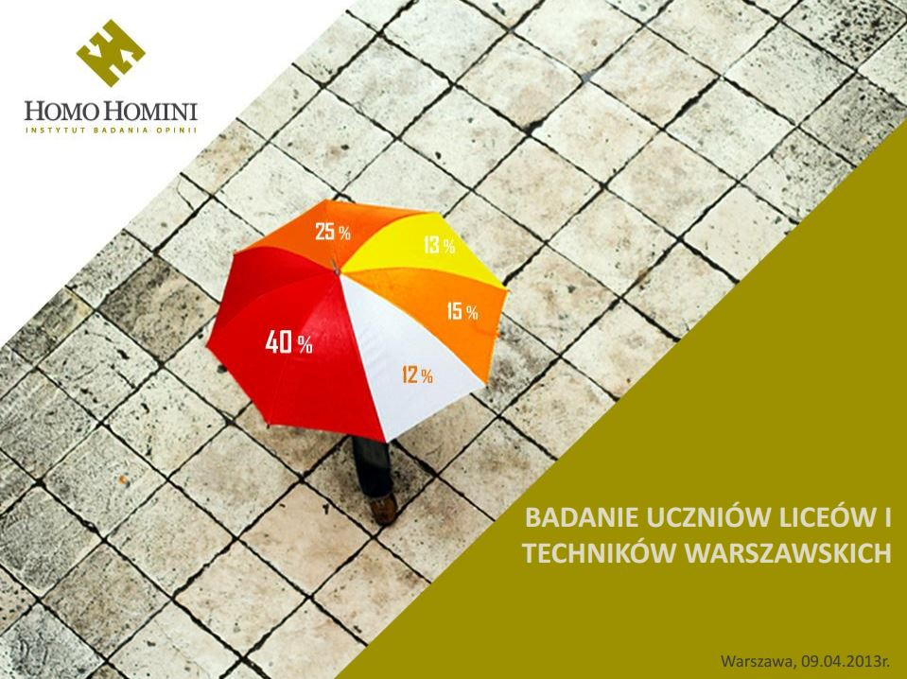
Anti-Semitism in Modern Polish Culture (cont.)
Recent polls indicate a rise in Anti-Semitic attitudes, especially among youth.
A 2012 poll taken of 20 Warsaw high schools found that 40% did not want Jewish class-mates, 44% did not want Jewish neighbors, and 61% did not want Jewish partners.
Source: antisemitism.org, “Poll: High antisemitism among Warsaw teens” http://antisemitism.org.il/article/78679/poll-high-antisemitism-among-warsaw-teens (accessed May 5, 2013).

Slide 12
Polish Attitudes Towards Anti-Semitism
It is important to restate that Polish Anti-Semitism is far less frequent and marked than the Anti-Semitism present in western European countries like France and England.
While Anti-Semitism has risen in the past 10 years, Anti-Anti-Semitism has risen to a larger degree over this time.
Organizations such as dificultquestions.org have come into being to help educate Polish youth and others against Anti-Semitism.
Source: Konstanty Gebert, difficultquestions.org, “Is it Dangerous to be a Jew in Poland Today” http://www.difficultquestions.org/ (accessed April 29, 2013).

Slide 13
Polish Government Response to Anti-Semitism
Poland and its Government have taken major action against Anti-Semitism, and to promote relations with Israel.
Whenever there are large scale Anti-Semitic incidents in Poland, the Government exercises strict punishment for those responsible.
Poland was the first of all the communist countries to re-establish ties with Israel after the fall of the USSR.
Source 1: cablegatesearch.net, “ATTITUDE SURVEYS OF QUESTIONABLE VALUE + ANTI-SEMITIC VIOLENCE RARE” http://www.cablegatesearch.net/cable.php?id=09WARSAW192 (accessed May 5, 2013).
Source 2: New York Times, “Poland Resumes Full Diplomatic Ties With Israel” http://www.nytimes.com/1990/02/28/world/poland-resumes-full-diplomatic-ties-with-israel.html (published December 28 1990, accessed May 5, 2013).
Notes:
http://www.nytimes.com/1990/02/28/world/poland-resumes-full-diplomatic-ties-with-israel.html

Slide 14
Polish Government Response to Anti-Semitism (Cont.)
In 2012, when the Anti Defamation League (ADL) invited 56 European states to discuss Anti-Semitism in their countries, Poland hosted the convention in Warsaw.
http://www.youtube.com/watch?v=egBwxeqjyVs
Source: adl.org, “ADL Urges European Governments To ‘Condemn And Combat Anti-Semitism’” http://www.adl.org/press-center/press-releases/anti-semitism-international/adl-urges-european.html (accessed May 5, 2013).

Slide 15
Response of the Jewish Community
Many Polish Jews say that, although Anti-Semitic attitudes are widespread, Anti-Semitic acts occur far less often than in the rest of Europe.
Members of the Jewish community generally agree that Poland is “less dangerous” for Jews than other Western European countries and say they feel “safer”.
Jewish leaders also recognize that Poland has more “promoters” of Jewish culture, such as mayors and community leaders who support Jewish cultural events and youth exchange programs.
Source: cablegatesearch.net, “ATTITUDE SURVEYS OF QUESTIONABLE VALUE + ANTI-SEMITIC VIOLENCE RARE + HIGH MARKS FOR POLISH LEADERS” http://www.cablegatesearch.net/cable.php?id=09WARSAW192 (accessed May 5, 2013).
Notes:
http://www.cablegatesearch.net/cable.php?id=09WARSAW192

Slide 16
In Conclusion
Pro-Palestinian/anti Israel events and rallies in Poland are incredibly small, and almost always peaceful.
Although there are some random attacks against Jews on the streets, these attacks are verbal, and are usually quickly ended by bystanders.
Although Poland is a relatively safe country for Jews, it is not completely devoid of Anti-Semitic sentiments and actions.
Source: Konstanty Gebert, difficultquestions.org, “Is it Dangerous to be a Jew in Poland Today” http://www.difficultquestions.org/ (accessed April 29, 2013).

Slide 17
Bibliography
Anti Defamation League. “ADL Urges European Governments To ‘Condemn And Combat Anti-Semitism’.” adl.org. http://www.adl.org/press-center/press-releases/anti-semitism-international/adl-urges-european.html (accessed May 5, 2013).
Blobaum, Robert Antisemitism and its Opponents in Modern Poland. New York: Cornell University Press, 1996.
cablegatesearch.net. “ATTITUDE SURVEYS OF QUESTIONABLE VALUE + ANTI-SEMITIC VIOLENCE RARE + HIGH MARKS FOR POLISH LEADERS” http://www.cablegatesearch.net/cable.php?id=09WARSAW192 (accessed May 5, 2013).
Datner, Helena. “Are there any Jews still living in Poland.” difficultquestions.org. http://www.difficultquestions.org/ (accessed April 29, 2013).
Gebert, Konstanty. “Is it Dangerous to be a Jew in Poland Today” difficultquestions.org. http://www.difficultquestions.org/ (accessed April 29, 2013).
Hagen, William W. “Before the "Final Solution": Toward a Comparative Analysis of Political Anti-Semitism in Interwar Germany and Poland.”In The Journal of Modern History. Vol. 68, No. 2. June 1996. p351–381.
Jewish Encyclopedia. “Statistics.” jewishencyclopedia.com. http://www.jewishencyclopedia.com/articles/13992-statistics (accessed May 5, 2012).
Johnson, Lonnie R. Central Europe: Enemies, Neighbors, Friends. London: Oxford University Press, 1996.
New York Times. “Poland Resumes Full Diplomatic Ties With Israel.” http://www.nytimes.com/1990/02/28/world/poland-resumes-full-diplomatic-ties-with-israel.html (published December 28 1990, accessed May 5, 2013).

Slide 18
Bibliography (cont.)
Shalom Life. “EXCLUSIVE: Adam Zucker’s ‘The Return’ Explores Jewish Culture in Modern Poland.” shalomlife.com. http://www.shalomlife.com/culture/19185/exclusive-adam-zuckers-the-return-explores-jewish-culture-in-modern-poland/ (accessed may 5, 2013).
The Coordination Forum for Countering Antisemitism. “Events Map 2013.” antisemitism.org. http://antisemitism.org.il/eventsmap/en/2013 (accessed May 5, 2013).
The Coordination Forum for Countering Antisemitism. “Poll: High antisemitism among Warsaw teens” antisemitism.org. http://antisemitism.org.il/article/78679/poll-high-antisemitism-among-warsaw-teens (accessed May 5, 2013).
The Jewish Museum. “Paradisus Iudaeorum.” jewishmuseum.org, http://www.jewishmuseum.org.pl/en/cms/paradisus-iudaeorum/ (accessed May 5, 2012).
United States Holocaust Memorial Museum. “Jewish Population of Europe in 1945.” ushmm.org. http://www.ushmm.org/wlc/en/article.php?ModuleId=10005687 (accessed May 5, 2012).

